Slide 1

END SEMESTER PROJECT
A PERFORMANCE BASED TEST
Muizzah Khan | Hiba Nasir

Slide 2
INTRODUCTION
UTILIZES OOP + DATA STRUCTURE + QT GRAPHICS
USER FRIENDLY QT WIDGET/GUI
2 SUBJECTS AVAILABLE
3 LEVELS OF TESTING
AUTOMATIC LEVELLING UP OR DOWN DEPENDING ON USER PERFORMANCE
MARKS CALCULATE AT END (OUT OF 5)

Slide 3
OBJECTIVES:
TO IMPLEMENT ‘TREES’ TO STORE ALL POSSIBLE OUTCOMES OF THE STUDENT’S LEVELLING
TO IMPLEMENT ‘LINKED LISTS’ TO STORE QUESTIONS/ANSWERS ACCORDING TO LEVEL
IMPLEMENT QT GRAPHICS AND LEARN HOW TO MAKE A GUI

Slide 4
LANGUAGE AND SOFTWARE
CORE CONCEPTS OF C++, NAMELY, FILE HANDLING, DATA STRUCTURES, ALOGRITHMS AND OOP USING DEV C++
QT’S DECLARATIVE UI LANGUAGE AND C++
QT CREATOR VERSION 4.14.0 FOR A GRAPHICAL INTERFACE

Slide 5

CODE EXPLAINED: HEADPHONES RECOMMENDED (VIDEO)

Slide 6
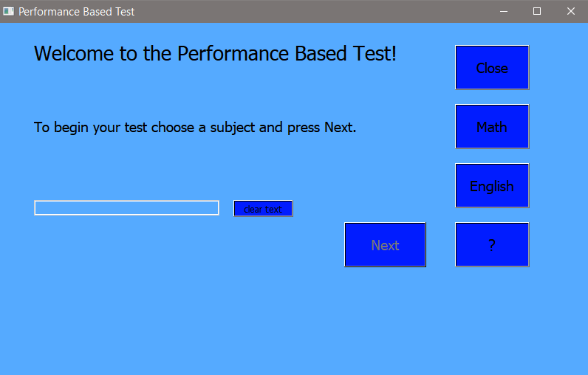
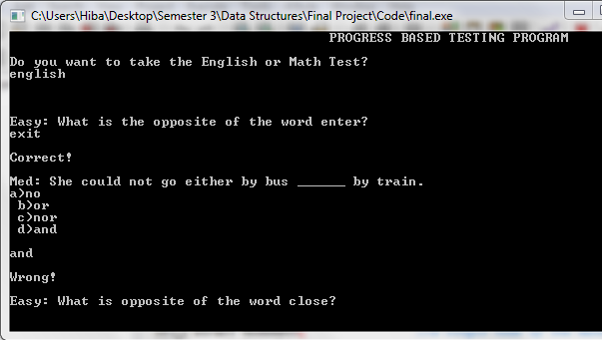
OUTPUT: In case of unavailability of QT you may run the console version using Dev C++ or Visual Studios.

Slide 7
OUTPUT DEMONSTRATED: (Video)

Slide 8
CONCLUSION
THIS PROJECT MPROVED OUR SKILLS IN DATA STRUCTURES AND ALOGORITHMS.
WE BECAME FAMILIAR WTH GRAPHICS
WE FACED SEVERAL OBSTACLES AND LEARNED TO SOLVE THEM AS A TEAM
WE UTLIZED A NEW SOFTWARE AND FAMILIARIZRD OUTRSELVES WITH WIDGETS
THIS PROJECT IS AN ATTEMPT AT MAKING TESTS IN SCHOOLS MORE EFFICIENT AND PAPER FREE

